Slide 1

CS49J Project
Completed by:
Mahir Labib
Changhyun Oh
Hyeyeon Im
Minse Ha

Slide 2
Context
Introduction
Project Topic
Program Structure
Input page class
Abstract class - Quiz Frame
Interface class - Score function
Subclasses - Each Quiz
Ranking Process
Demo

Slide 3



1. Introduction
01
02
What did we use?
Goal
Learn java object oriented programming
Understand the concepts of abstract and interface and apply to programs
Implement fun Games for students through Java!

Slide 4
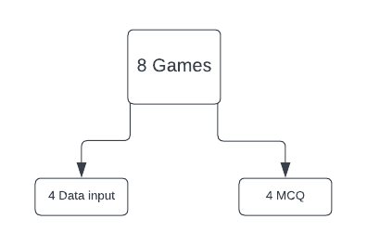
2. Project Topic: Quiz game
Eight games divided into two types
Four questions → input answers
Four questions → True / False
Getting user’s information by input

Slide 5


2. Project Topic: Quiz game
Ranking system
UI for data input

Slide 6
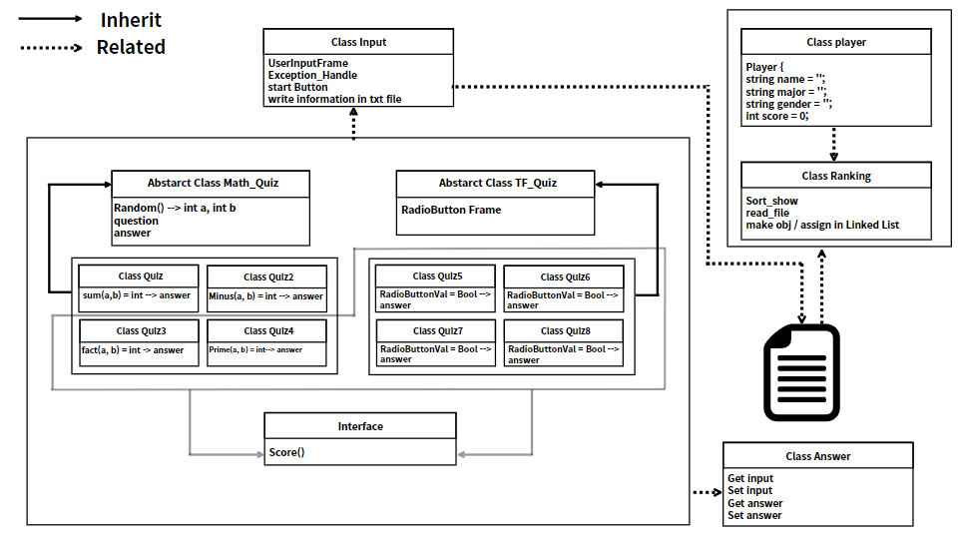
3. Program Structure
High level view
2 Abstract classes
8 subclasses
4 Concrete classes
1 Interface class

Slide 7
3. Program Structure
Eight of the Quiz subclasses extend the the two Abstract class
Quiz from 3-8 implements interface

Slide 8
3. Program Structure
File read by “Ranking” class
When the file is read, one student will be assigned to one object of “Player” class

Slide 9
4. Input class
Get the user’s input
Handle the wrong input with try/catch
Implement State button
Write user input in txt file

Slide 10

5. Abstract class
1. Math_Quiz
2. TF_Quiz

Slide 11
5. Abstract Class: Math_Quiz
Create Quiz Frame
Generate Random num
Questions
Answers
Packages used
java.awt
For user interface
java.swing
JFrame
java.random
Randomly generate the upper and lower bounds

Slide 12
5. Abstract Class: TF_Quiz
Create quiz Frame
Create Radio button
Packages used
java.awt
For user interface
java.swing
JFrame

Slide 13
6. Interface : Quiz_interface
Every quiz class will implement this interface
This interface force subclasses must create their own score function
By score method, we can count the quiz score for each quiz

Slide 14
7. Sub-classes
Q1_sum
Q2_Factorial
Q3_Multiply
Q4_PrimeNum
5. Q5_TF1
6. Q6_TF2
7. Q7_TF3
8. Q8_TF4

Slide 15
7. Sub-classes
Packages used:
Java.io
bufferWriter
java.awt
For user interface
FileWriter
java.swing
JFrame
IOException
PrintWriter

Slide 16
7. Sub-classes
Input questions 1 and 2
Q1_Sum
1
Asks the user to input the value of sum on two values
Q2_Subtract
2
Asks the user to input the value of subtraction on two values

Slide 17
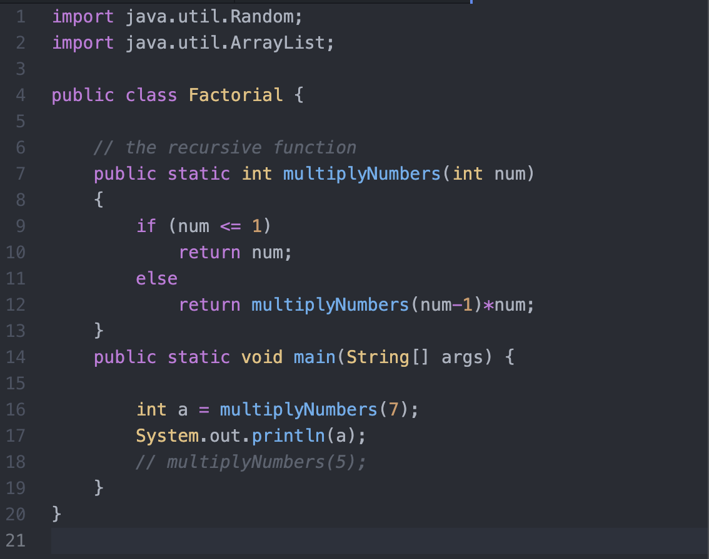
7. Sub-classes
3
Q3_Factorial
Prompts the user to calculate and input the value of factorial
Utilisation of recursive function

Slide 18
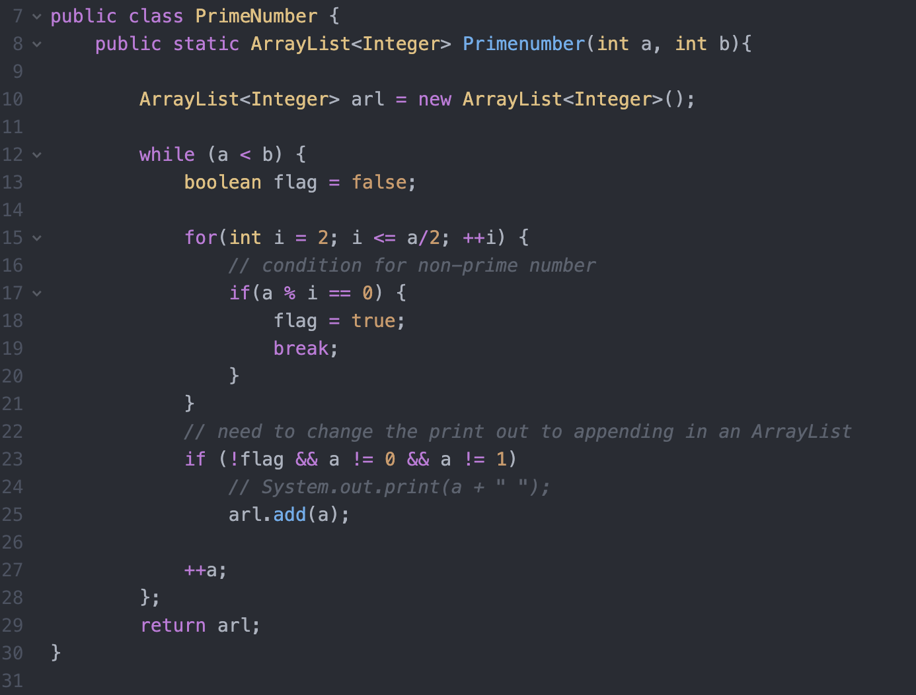
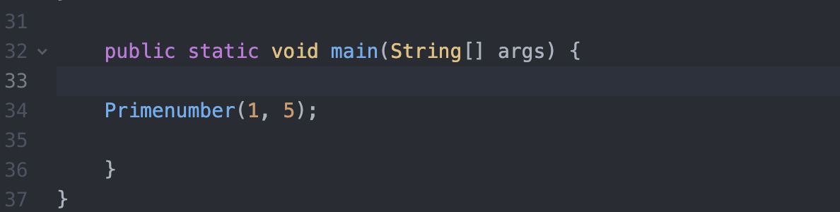
7. Sub-classes
4
Q4_PrimeNumber
Prompts the user to calculate and input the value of factorial
Utilisation of recursive function

Slide 19
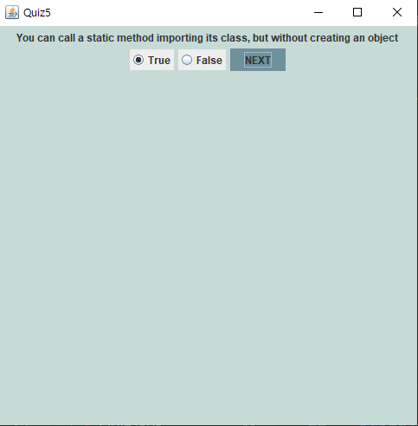

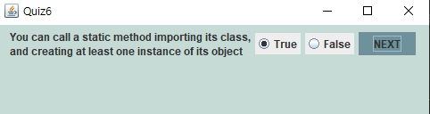
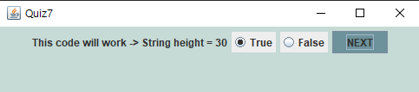
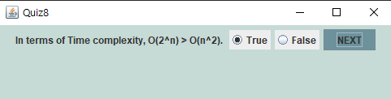
7. Sub-classes
~Based on Boolean~
5
6
7
8

Slide 20
8. Ranking Process

Slide 21
8-1. Sequence of Ranking System
1. Write input(user information) in Class input to txt file
2. By using score method in each quiz, count the score and write to txt file after finish quiz 8
3. Class Ranking check the length of lines of txt file
4. Class Ranking read the file, and assign each line to each Class Player instance.
5. Class Ranking store every Player instance in Linked list
6. Class Ranking sort the Linked list by score value
7. Class Ranking store the instance values of a sorted linked list in a string array
8. Class Ranking add jtable in screen with the string array

Slide 22
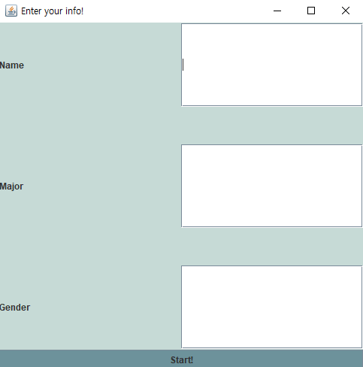
9. Demo

